Slide 1

Tools
Prof. Darrell Long
CSE 13S

Slide 2
In the Beginning was the Command Line…
When you login to unix.ucsc.edu you are communicating with a shell.
There is nothing magic about a shell, it is just another program.
It lets you type commands (the names of programs) and runs them for you.
The shell that you use is a matter of personal preference:
The original shell was called sh, or the Bourne Shell, after Stephen Bourne.
People who grew up with Berkeley UNIX typically prefer csh (the C Shell) or tcsh.
We will use bash, the Bourne-Again Shell, written by Brian Fox.
If you don’t like any of these, you can write your own.

Slide 3

bash
UNIX shells descend from sh — the Bourne Shell.
csh — the C Shell (from Berkeley).
tcsh — TENEX C Shell (C Shell evolution).
ksh — the Korn Shell (David Korn).
zsh — Falstad shell (extends ksh).
fish — Friendly Interactive Shell.
ash, rc (Plan 9), scsh, …
Stephen R. Bourne

Slide 4
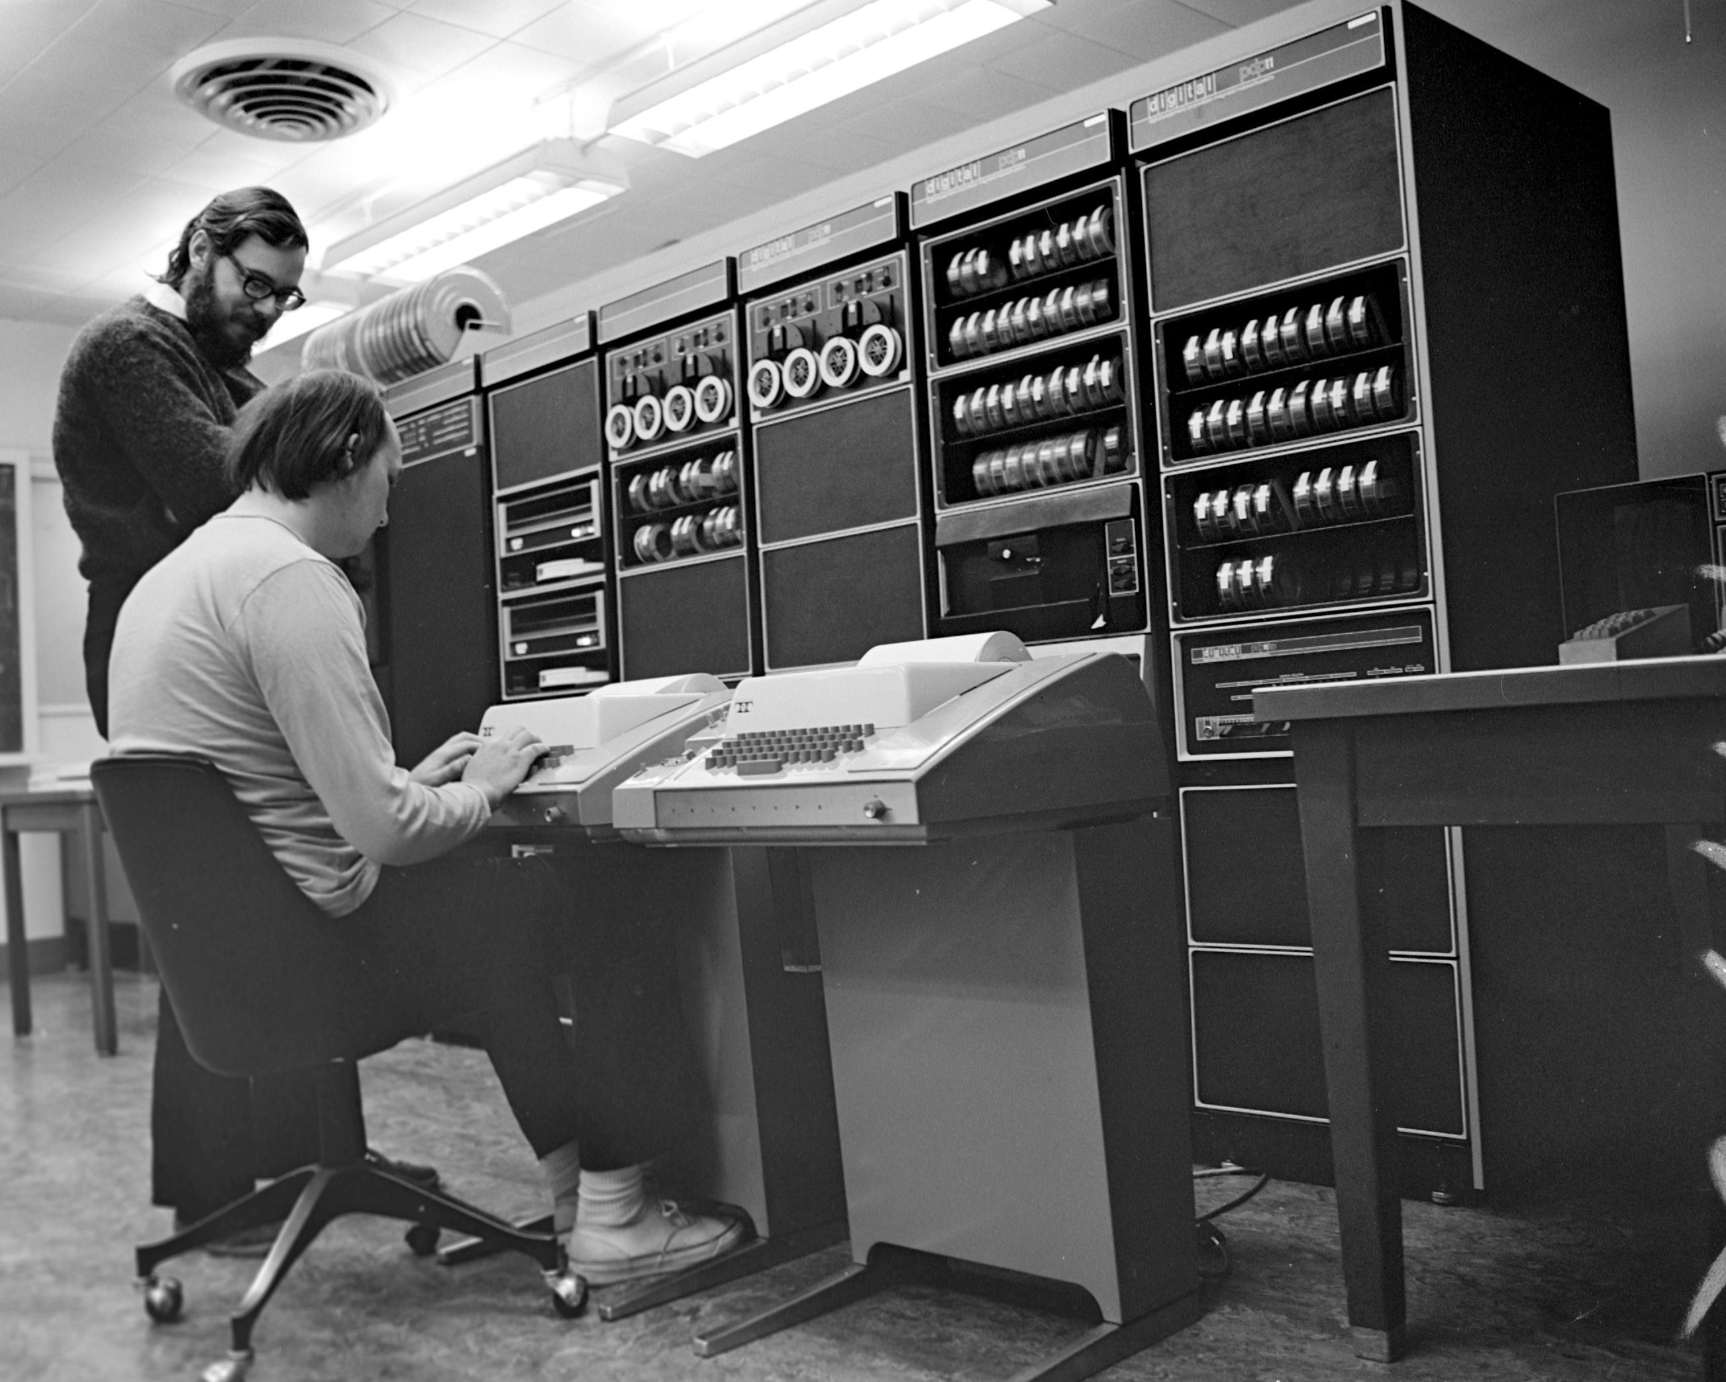
UNIX is based on a tools philosophy
Dennis
Ken
Ken Thompson & Dennis Ritchie

Slide 5
ls

Slide 6
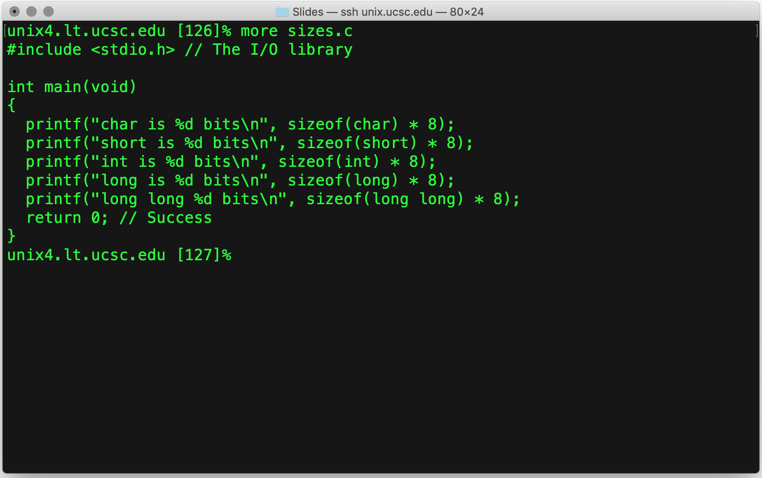
more / less / cat
cat (short for concatenate)
Copies files to stdout
more displays files one page at a time
Has some search capability
less is more complex than more
It has more capabilities,
But is pretty much the same

Slide 7
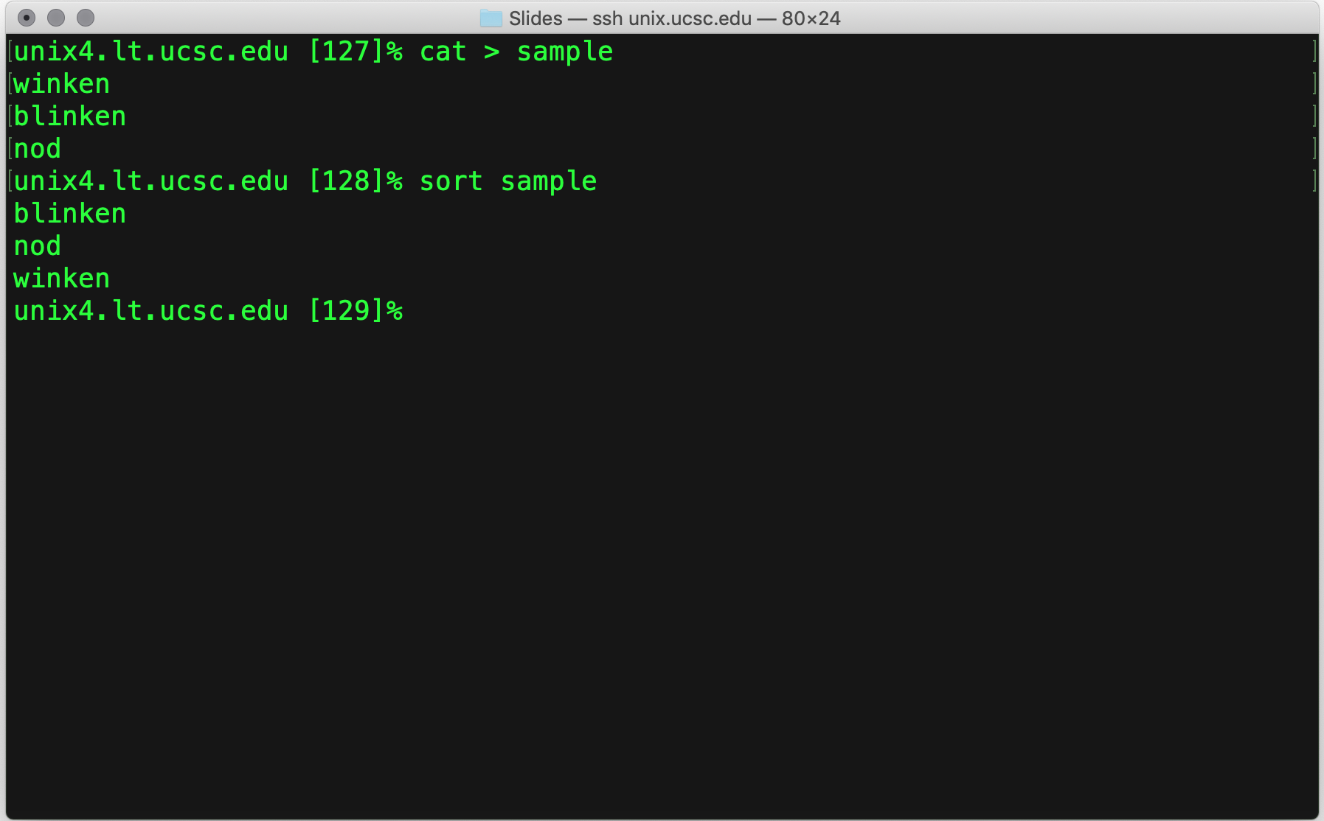
sort
Orders the contents of a file (or stdin)
It can be alphabetical, or
Numerical order.
Default is to sort stdin and write it to stdout
In keeping with the composable tools philosophy
There are many options

Slide 8
I/O Redirection

Slide 9
Pipes

Slide 10
cc / gcc / clang

Slide 11
make

Slide 12
man

Slide 13
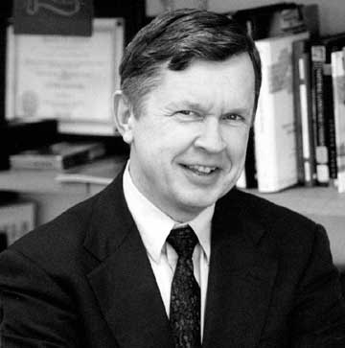
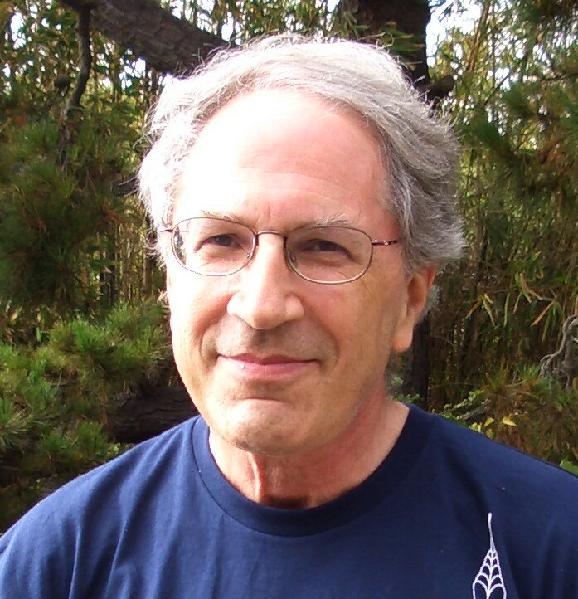
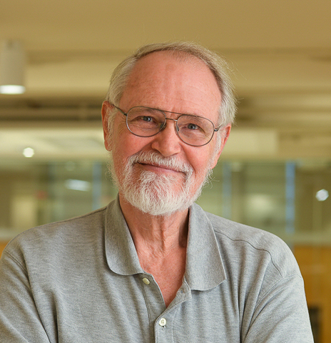
awk
Al Aho
Peter Weinberger
Brian Kernighan
A simple language for processing text files

Slide 14


